Slide 1
ZOO ANIMAL CLASSIFICATION DATASET
Ironhack Data Science and Machine Learning Bootcamp
Chantal Silva 26 October 2025

Slide 2
Introduction
Today I'll be presenting my analysis of the Zoo Animal Dataset, where I explored the characteristics and classifications of 101 different animal species.
This project represents a comprehensive data exploration journey - from initial data loading and quality assessment through to detailed univariate analysis and dataset preparation.
Using Python and key data science libraries, I worked with two primary datasets: one containing 18 different physical and behavioral characteristics for each animal, and another providing their biological classifications across 7 distinct categories.
Throughout this analysis, my focus was on ensuring data quality, understanding feature distributions, and preparing a clean, integrated dataset ready for further analysis or machine learning applications.
Let me walk you through the key steps and findings from this exploratory data analysis.
Notes:
Today I'll present my analysis of the Zoo Animal Dataset, where I explored 101 animals across 7 classifications. Using Python, I focused on data quality assessment, feature analysis, and dataset preparation to understand animal characteristics and build a foundation for further analysis.

Slide 3

Dataset Integrity
Zoo.csv: 101 animals × 18 features
Class.csv: 7 classes × 4 columns
Merged dataset: 101 × 22 columns
Clean, analysis-ready data - perfect data quality (no missing values or duplicates found)
Numerical variables: 19
Categorical variables: 2
Notes:
There were 2 datasets, which means I had to merge the 2 of them, so I could better reunite all the data and analyse the possible relationships between variables. The dataset cleaning was very easy as there were no missing values nor duplicates found

Slide 4

Analysis performed
Missing value analysis
Duplicate detection
Data type verification
Univariate analysis
Bivariate analysis
Notes:
When I performed the analysis, as already mentioned, I had to look for missing values and duplicates; then I checked for the data types in order to proceed with 2 univariate analysis and bivariate analysis

Slide 5
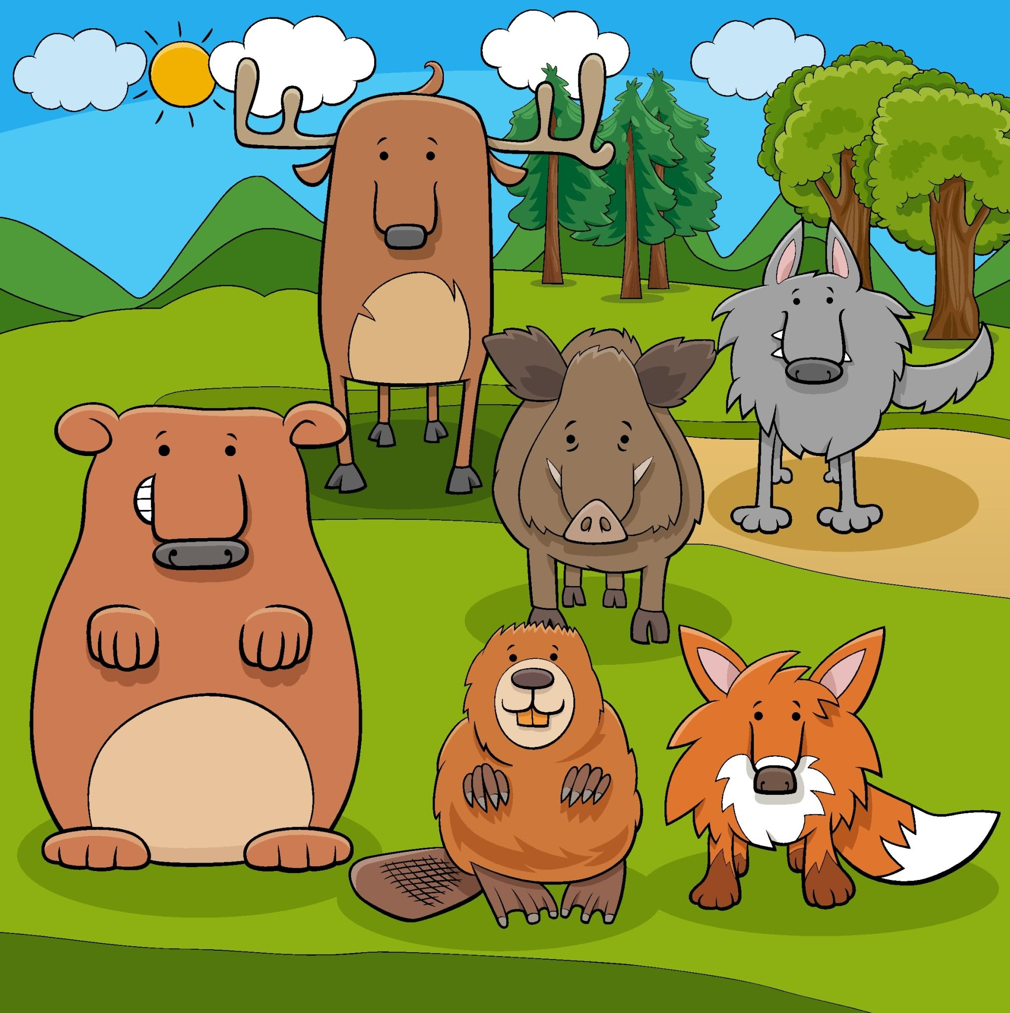
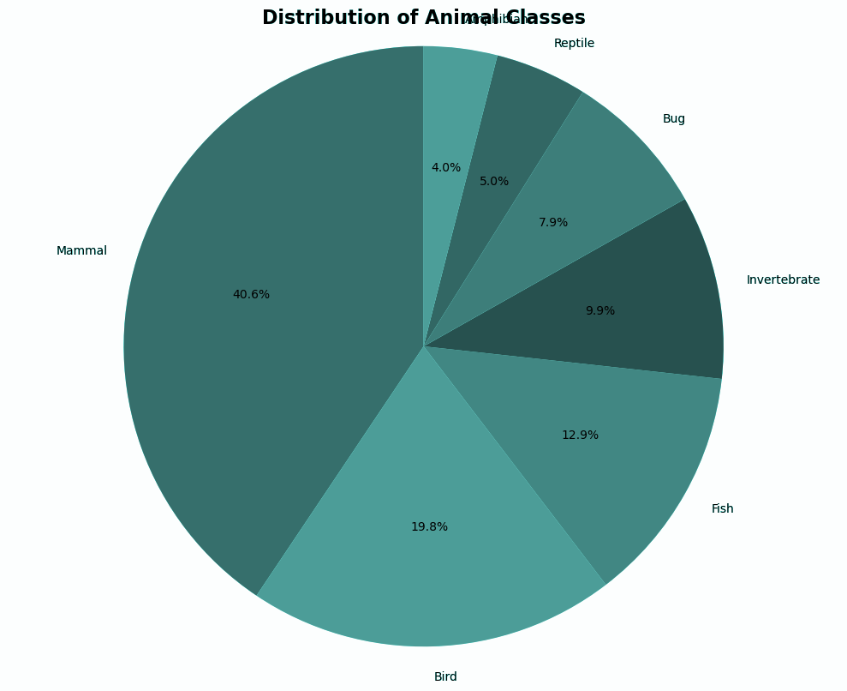
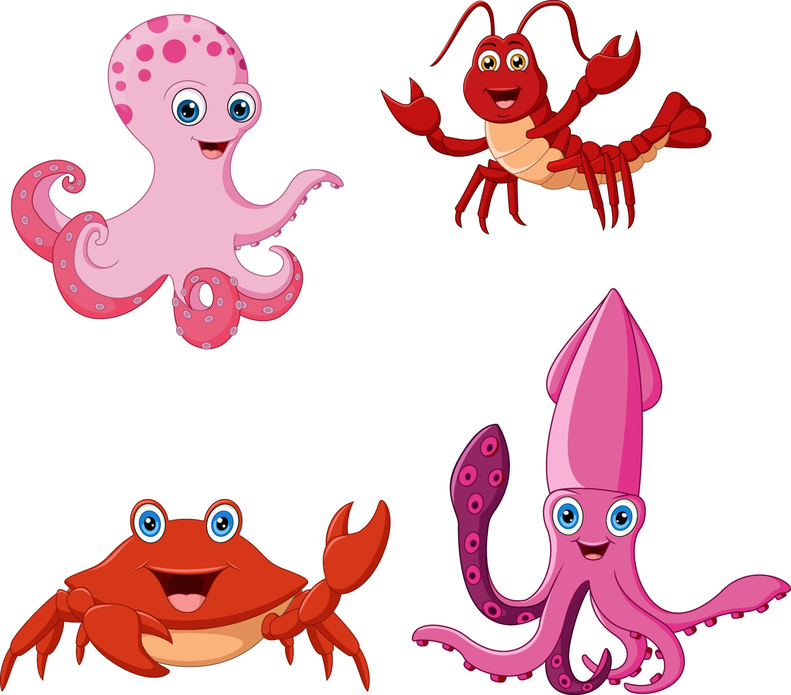
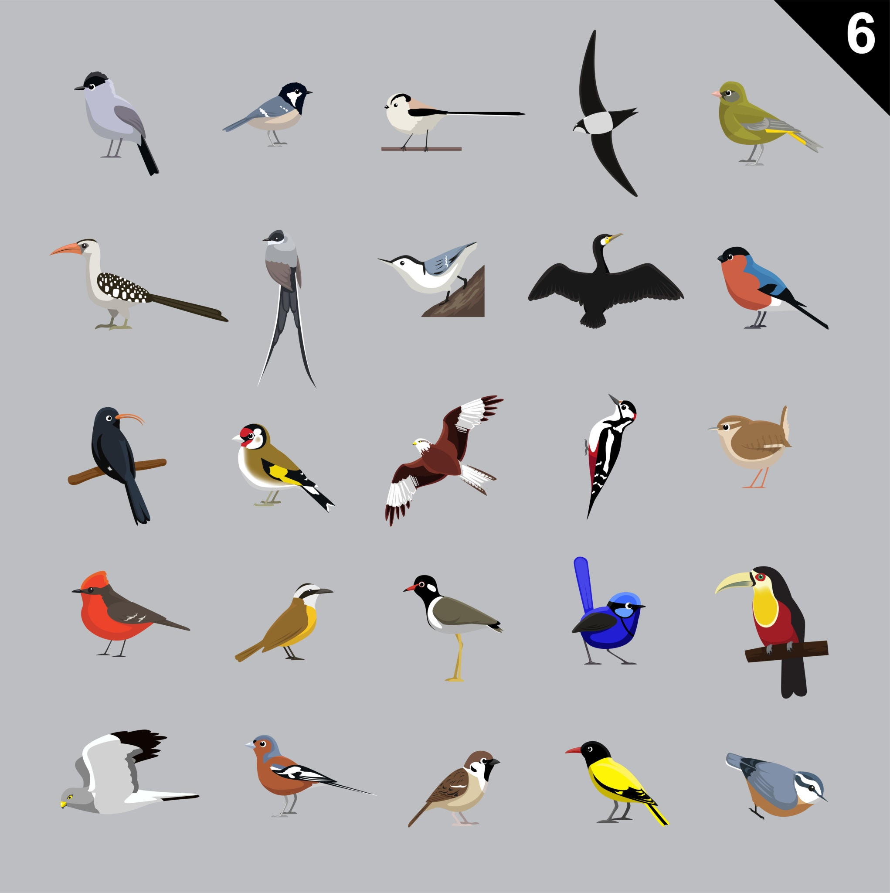
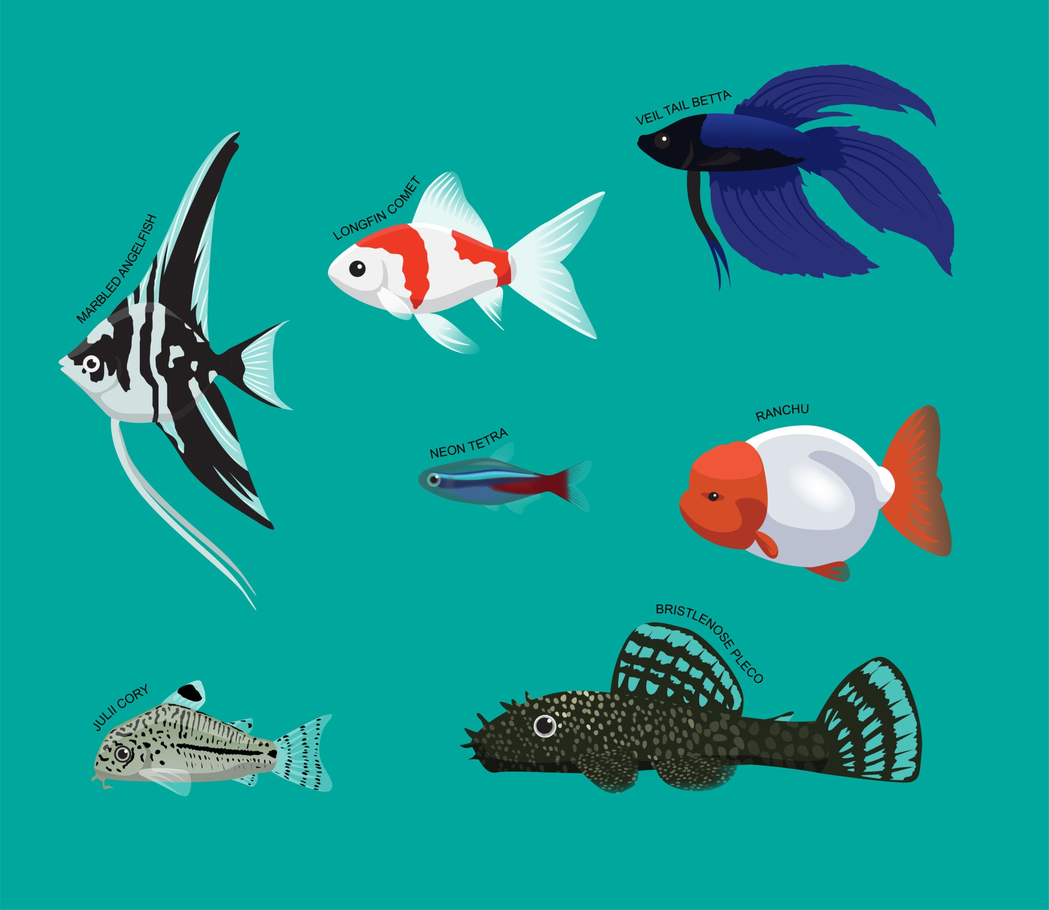
Distribution of 101 Animals Across 7 Classes
Amphibian

Slide 6
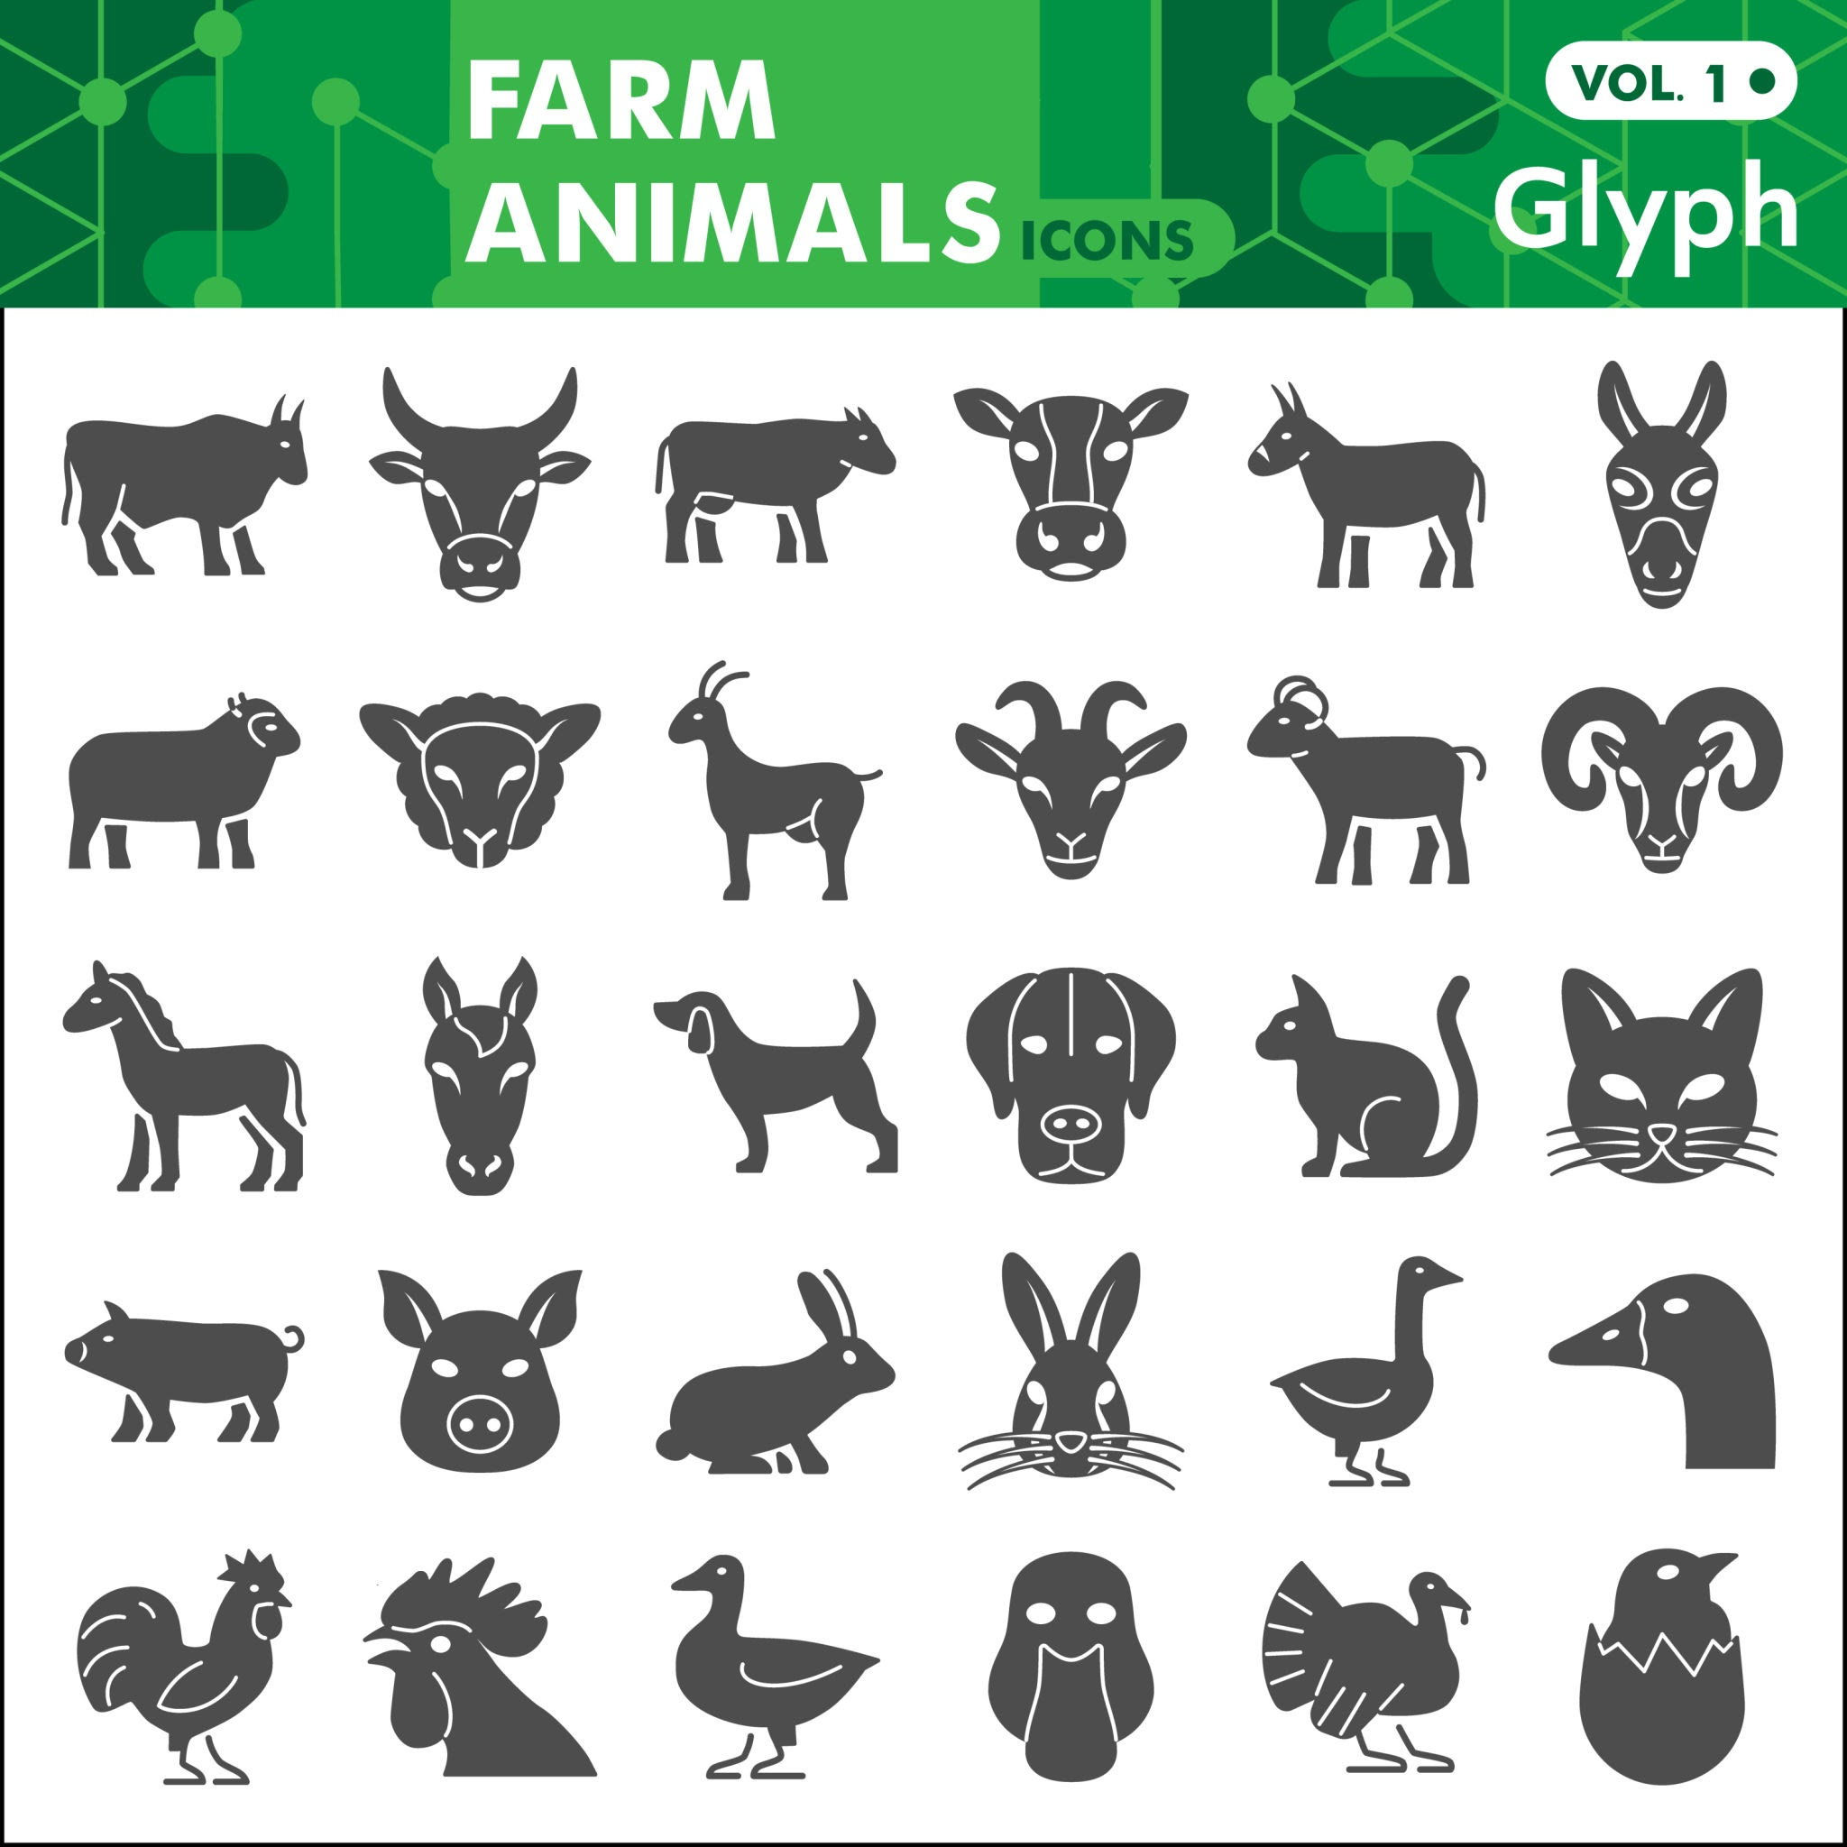
Identifying the variable types
Numerical Variables (19):
['hair', 'feathers', 'eggs', 'milk', 'airborne', 'aquatic', 'predator', 'toothed', 'backbone', 'breathes', 'venomous', 'fins', 'legs', 'tail', 'domestic', 'catsize', 'class_type', 'Class_Number', 'Number_Of_Animal_Species_In_Class']
Categorical Variables (2):
['Class_Type', 'Animal_Names']

Slide 7
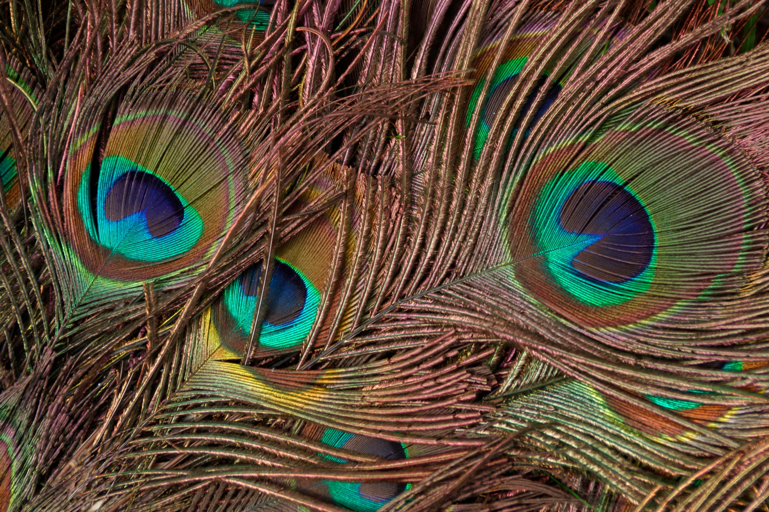
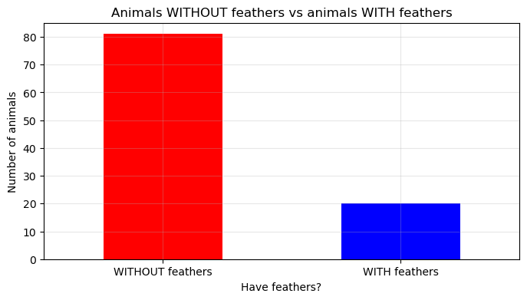
Univariate Analysis
How many animals have feathers?
COUNT:
feathers
0 81
1 20
Name: count, dtype: int64
SUMMARY:
81 animals WITHOUT feathers
vs
20 animals WITH feathers
Notes:
0 - without 1 - with

Slide 8
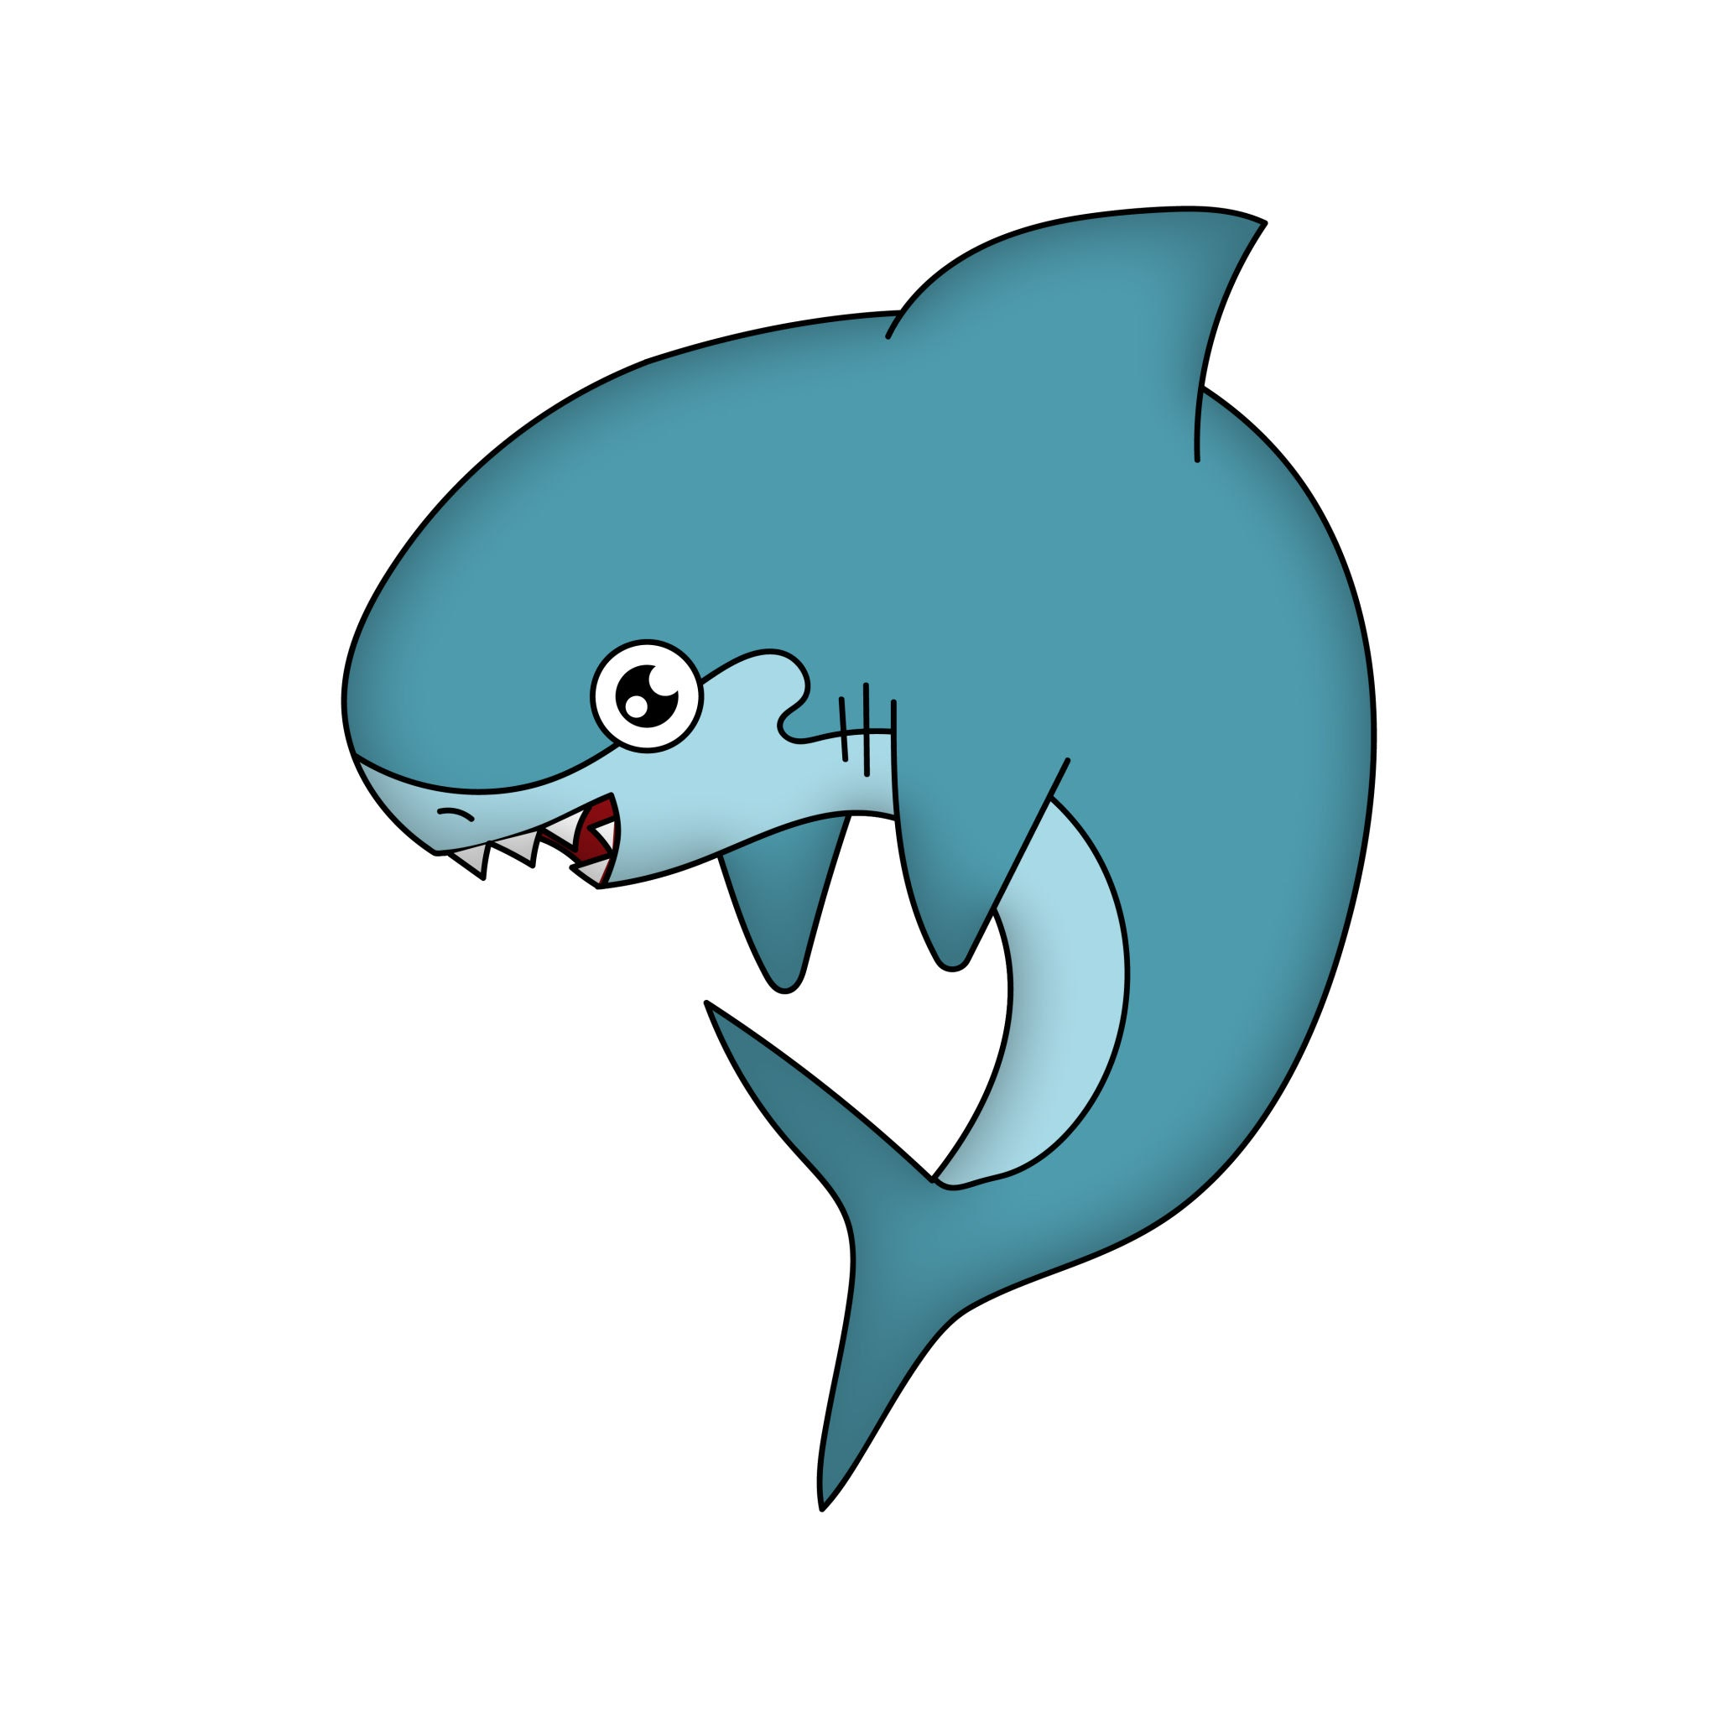
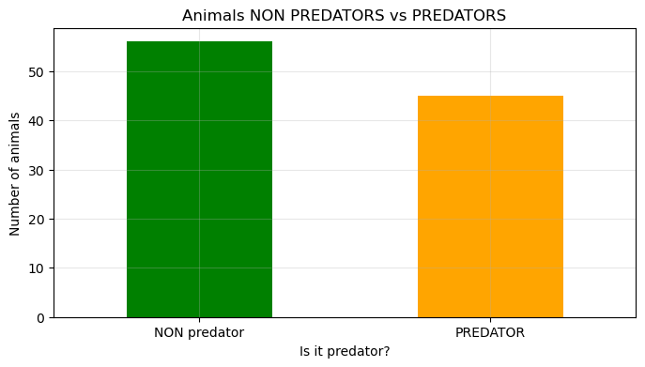
Univariate Analysis
How many animals are predators?
COUNT:
predator
1 56
0 45
Name: count, dtype: int64
SUMMARY:
45 NON predators
vs
56 Predators
Notes:
1 are predator
0 non predator

Slide 9
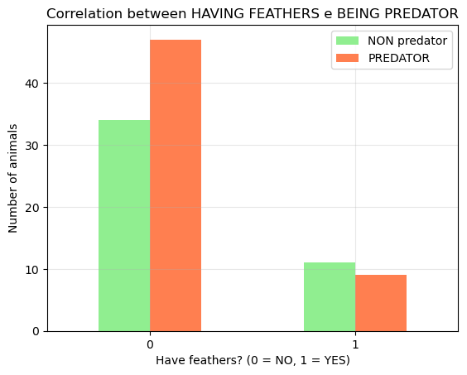
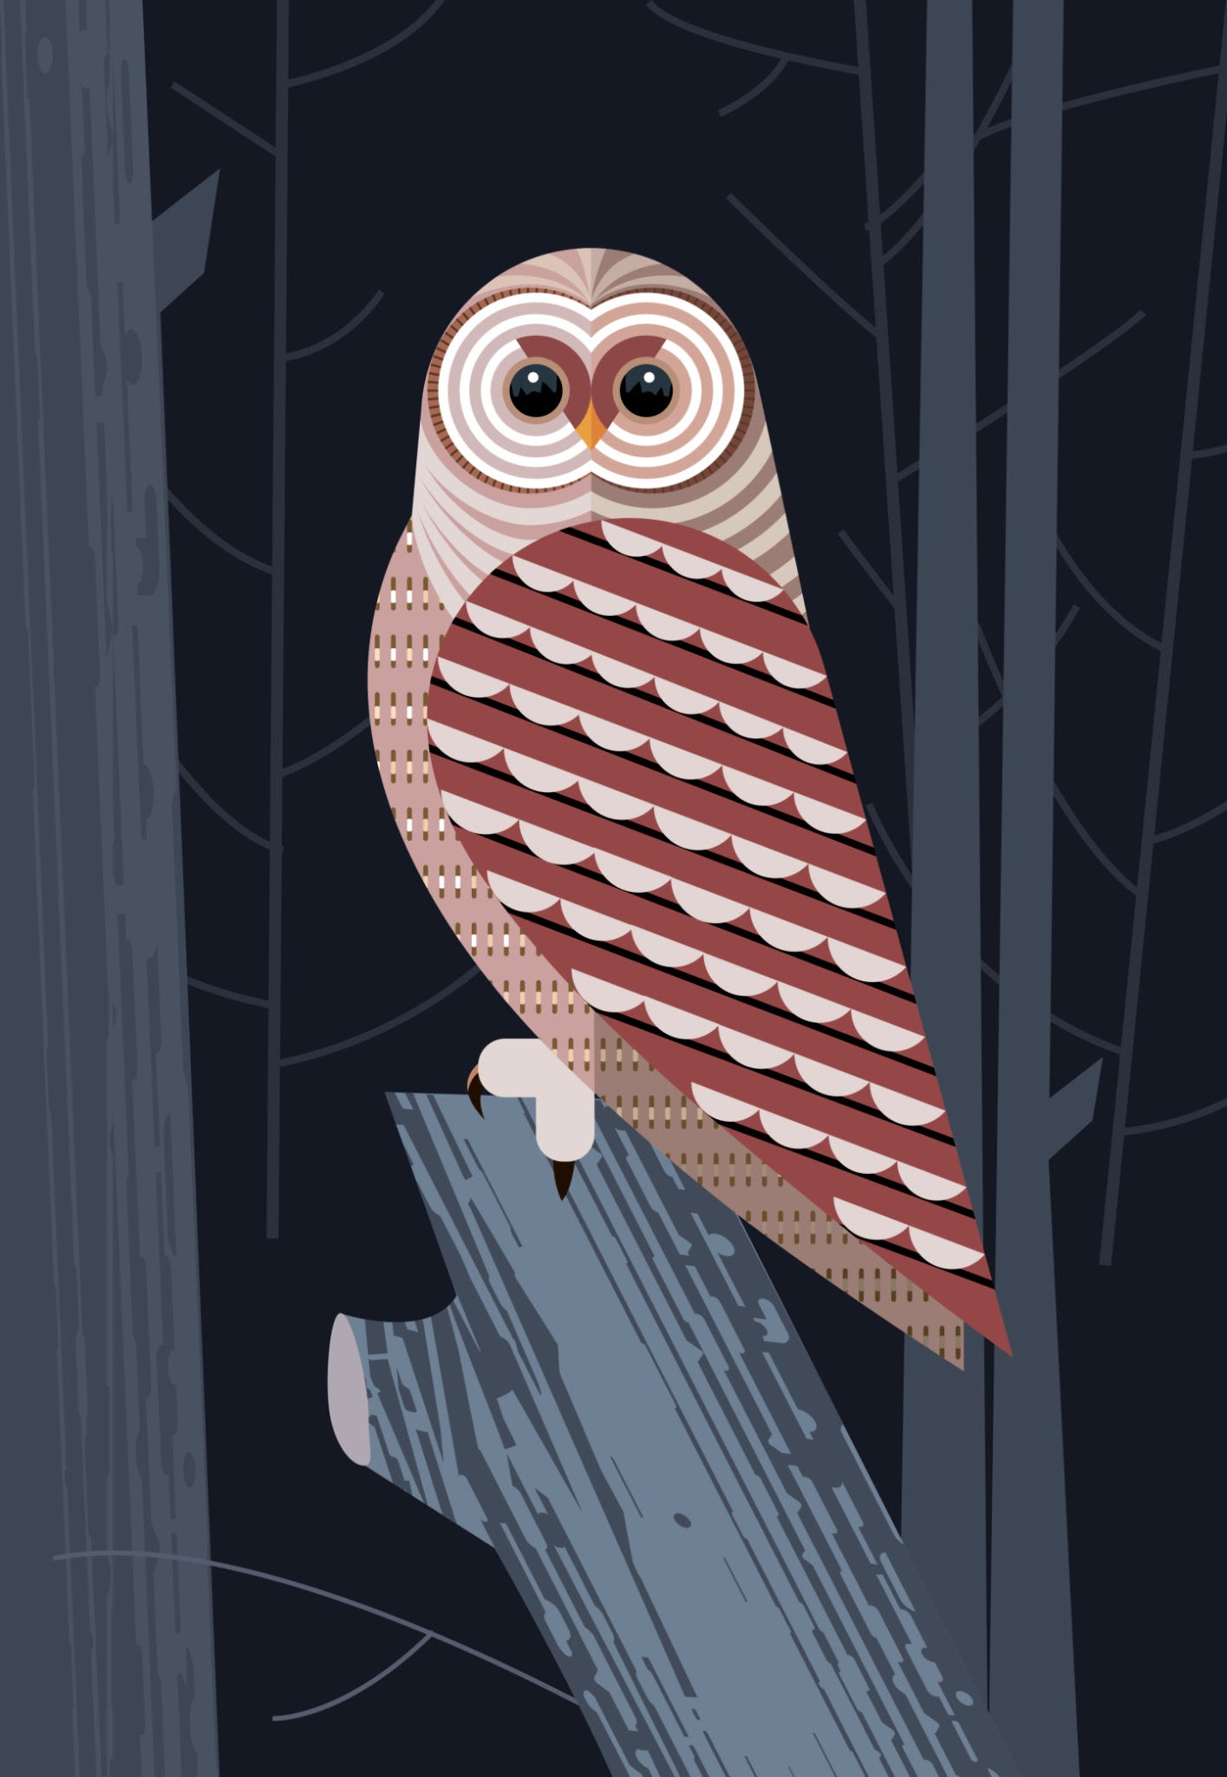
Bivariate Analysis
Are feathered animals more predatory?
FEATHERS vs PREDATORS TABLE:
predator 0 1
feathers
0 34 47
1 11 9
LEGEND:
- Rows: 0 = WITHOUT feathers, 1 = WITH feathers
- Columns: 0 = NON predator, 1 = PREDATOR
Notes:
This bivariate analysis graph shows that there are

Slide 10

Conclusions/Interpretation
Detailed analysis:
Animals WITHOUT feathers: 81 total
Animals WITH feathers: 20 total
Percentage of predators among animals WITHOUT feathers: 58.0%
Percentage of predators among animals WITH feathers: 45.0%
In conclusion:
- Animals WITH feathers tend NOT TO BE predators
- The animal class distribution shows clear biological patterns that reflect real-world biodiversity, making this dataset valuable for educational and research purposes.
Notes:
making a recap of the analysis: there are 81 animals without feathers, 20 with feathers 58% of the animals without feathers are predators and 45% of the animals with feathers are predators, which leads to the main conclusion that animals with feathers tend not to be predators

Slide 11

Next steps
Advanced visualization
Try probabilistic models
Correlation studies
Expanded dataset analysis
Collect additional species to balance minority classes/test generalization
Enrich dataset with additional species and finer taxonomic labels.
Multivariate analysis
Notes:
So, next steps to take for further analysis would be collecting more species, trying advanced visualization and probabilistic models, and so on

Slide 12
Thank you!
Q&A
Notes:
Thank you for watching my presentation, I hope you have enjoyed it and let me know if you have any questions!

